Slide 1
集中采购
Notes:
{
"template_id": "T004",
"page_index": 1,
"layout_type": "single_title",
"placeholders": [
{
"placeholder_id": "p1",
"type": "title",
"bbox": [0.1, 0.4, 0.8, 0.2],
"suggested_length": "4-8 chars",
"font_size": "44-60",
"note": "主标题，通常用于封面或章节分隔页"
}
],
"example_text": {
"title": "集中采购"
},
"text_capacity_score": 0.1,
"visual_density": 0.1,
"recommended_usage": [
"封面标题",
"章节分隔页",
"核心主题展示"
],
"style_tags": ["极简", "标题突出", "居中布局", "浅色背景"]
}

Slide 2
传统采购管理与现
代采购管理的区别
Notes:
{
"template_id": "T004",
"page_index": 1,
"layout_type": "single_title",
"placeholders": [
{
"placeholder_id": "p1",
"type": "title",
"bbox": [0.1, 0.4, 0.8, 0.2],
"suggested_length": "10-30 chars",
"font_size": "44-60",
"note": "主标题，通常用于封面或章节分隔页"
}
],
"example_text": {
"title": "传统采购管理与现代采购管理的区别"
},
"text_capacity_score": 0.1,
"visual_density": 0.1,
"recommended_usage": [
"封面标题",
"章节分隔页",
"核心主题展示"
],
"style_tags": ["极简", "标题突出", "居中布局", "浅色背景"]
}

Slide 3

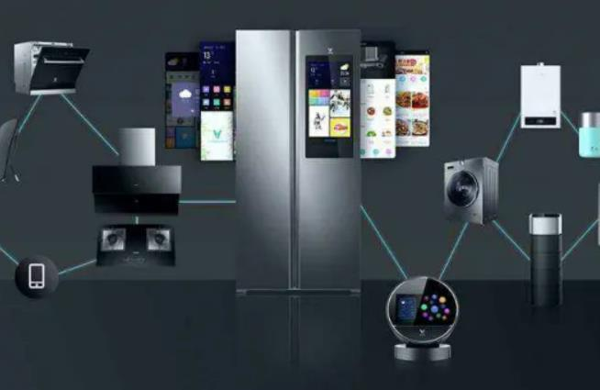
公司采购
——集中采购的优缺点
企业集团下有生产电视、冰箱、电脑等不同产品的子公司，因所需物料通用性低，不太适合完全采用集中采购。
Notes:
{
"template_id": "T032",
"page_index": 1,
"layout_type": "title_left_image_right_text",
"placeholders": [
{
"placeholder_id": "p1",
"type": "title",
"bbox": [0.1, 0.1, 0.8, 0.15],
"suggested_length": "5-15 chars",
"font_size": "40-52",
"note": "主标题（大纲中的二级标题），整体主题名称"
},
{
"placeholder_id": "p2",
"type": "image",
"bbox": [0.1, 0.3, 0.4, 0.55],
"note": "左侧图片区域，用于展示相关示意图、图表或案例图片"
},
{
"placeholder_id": "p3",
"type": "body",
"bbox": [0.55, 0.3, 0.35, 0.55],
"suggested_length": "100-300 chars",
"font_size": "20-28",
"note": "右侧长文本区域，用于详细说明或案例分析"
}
],
"example_text": {
"title": "集中采购的优缺点",
"body": "企业集团下有生产电视、冰箱、电脑等不同产品的子公司，因所需物料通用性低，不太适合完全采用集中采购。"
},
"text_capacity_score": 0.5,
"visual_density": 0.4,
"recommended_usage": [
"优缺点分析",
"案例图文说明",
"限制条件阐述",
"图文结合展示"
],
"style_tags": ["图文结合", "左侧图片右侧文字", "简洁清晰", "浅色背景"]
}

Slide 4


公司采购
——分散采购定义
分散采购是指采购活动由各需求单位分散进行。也就是说，每个事业部或者每个部门根据自身的需求，自己负责采购事宜。
Notes:
{
"template_id": "T006",
"page_index": 1,
"layout_type": "title_with_definition",
"placeholders": [
{
"placeholder_id": "p1",
"type": "title",
"bbox": [0.15, 0.15, 0.7, 0.15],
"suggested_length": "5-10 chars",
"font_size": "36-48",
"note": "主标题（大纲中的副标题），概念名称"
},
{
"placeholder_id": "p2",
"type": "body",
"bbox": [0.15, 0.4, 0.7, 0.5],
"suggested_length": "100-200 chars",
"font_size": "20-28",
"note": "概念定义正文，详细解释说明"
}
],
"example_text": {
"title": "分散采购定义",
"body": "分散采购是指采购活动由各需求单位分散进行。也就是说，每个事业部或者每个部门根据自身的需求，自己负责采购事宜。"
},
"text_capacity_score": 0.65,
"visual_density": 0.25,
"recommended_usage": [
"概念定义",
"术语解释",
"名词说明",
"基础知识介绍"
],
"style_tags": ["简洁", "文字主导", "概念清晰", "浅色背景"]
}

Slide 5

公司采购
——分散采购的优缺点
某国有企业曾放权让利，各分厂自行采购，出现采购价格不一、物料质量参差不齐等问题。
Notes:
{
"template_id": "T008",
"page_index": 1,
"layout_type": "title_with_text_and_image",
"placeholders": [
{
"placeholder_id": "p1",
"type": "title",
"bbox": [0.1, 0.1, 0.8, 0.15],
"suggested_length": "5-15 chars",
"font_size": "40-52",
"note": "主标题（大纲中的副标题），概念或主题名称"
},
{
"placeholder_id": "p2",
"type": "body",
"bbox": [0.1, 0.3, 0.55, 0.55],
"suggested_length": "150-400 chars",
"font_size": "20-28",
"note": "长文本区域，用于详细的案例分析或问题描述"
},
{
"placeholder_id": "p3",
"type": "image",
"bbox": [0.68, 0.3, 0.25, 0.55],
"note": "图片区域，用于放置与内容相关的示意图、图表或案例图片"
}
],
"example_text": {
"title": "分散采购的优缺点",
"body": "某国有企业曾放权让利，各分厂自行采购，出现采购价格不一、物料质量参差不齐等问题。"
},
"text_capacity_score": 0.6,
"visual_density": 0.4,
"recommended_usage": [
"案例分析配图说明",
"优缺点图文阐述",
"问题描述与图解",
"实践案例展示"
],
"style_tags": ["图文结合", "左侧文字右侧图片", "案例分析", "浅色背景"]
}

Slide 6
公司采购
——集中采购定义
集中采购是指企业或企业集团的采购活动由专门的采购部门集中进行。
日常生活中的团购，通过整合需求形成规模优势，从而获得更好的价格和服务。
Notes:
{
"template_id": "T009",
"page_index": 1,
"layout_type": "title_text_image_right",
"placeholders": [
{
"placeholder_id": "p1",
"type": "title",
"bbox": [0.1, 0.1, 0.8, 0.15],
"suggested_length": "5-15 chars",
"font_size": "40-52",
"note": "主标题（大纲中的二级标题），概念名称"
},
{
"placeholder_id": "p2",
"type": "body",
"bbox": [0.1, 0.3, 0.55, 0.55],
"suggested_length": "150-400 chars",
"font_size": "20-28",
"note": "长文本区域，用于详细的概念定义和说明"
},
{
"placeholder_id": "p3",
"type": "image",
"bbox": [0.68, 0.3, 0.25, 0.55],
"note": "图片区域，用于放置与概念相关的示意图或示例图片"
}
],
"example_text": {
"title": "集中采购定义",
"body": "集中采购是指企业或企业集团的采购活动由专门的采购部门集中进行。日常生活中的团购，通过整合需求形成规模优势，从而获得更好的价格和服务。"
},
"text_capacity_score": 0.65,
"visual_density": 0.4,
"recommended_usage": [
"概念定义配图",
"术语图文解释",
"定义与示例结合展示",
"知识讲解"
],
"style_tags": ["图文结合", "左侧文字右侧图片", "概念说明", "浅色背景"]
}

Slide 7
公司采购
——混合制采购
实际操作中，很多企业采用混合制采购模式，结合集中采购和分散采购优点。对于通用性强、采购金额大的核心物料，集中采购获规模效应；小额、个性化、因地制宜或临时性采购需求，由各用料单位分散进行。
Notes:
{
"template_id": "T033",
"page_index": 1,
"layout_type": "title_with_body",
"placeholders": [
{
"placeholder_id": "p1",
"type": "title",
"bbox": [0.15, 0.15, 0.7, 0.15],
"suggested_length": "5-10 chars",
"font_size": "36-48",
"note": "主标题（大纲中的副标题），概念或模式名称"
},
{
"placeholder_id": "p2",
"type": "body",
"bbox": [0.1, 0.4, 0.8, 0.5],
"suggested_length": "150-400 chars",
"font_size": "20-28",
"note": "长文本区域，用于详细的概念解释、模式说明或优势分析"
}
],
"example_text": {
"title": "混合制采购",
"body": "实际操作中，很多企业采用混合制采购模式，结合集中采购和分散采购优点。对于通用性强、采购金额大的核心物料，集中采购获规模效应；小额、个性化、因地制宜或临时性采购需求，由各用料单位分散进行。"
},
"text_capacity_score": 0.7,
"visual_density": 0.2,
"recommended_usage": [
"模式或概念解释",
"复合策略说明",
"优缺点结合阐述",
"实践应用介绍"
],
"style_tags": ["简洁", "文字主导", "概念清晰", "浅色背景"]
}

Slide 8
集中采购、分散采购与联合采购
优化采购流程
降低成本
Notes:
{
"template_id": "T023",
"page_index": 1,
"layout_type": "title_with_two_bullet_points",
"placeholders": [
{
"placeholder_id": "p1",
"type": "title",
"bbox": [0.1, 0.15, 0.8, 0.18],
"suggested_length": "10-25 chars",
"font_size": "40-55",
"note": "主标题（大纲中的副标题），列举多个相关概念"
},
{
"placeholder_id": "p2",
"type": "body",
"bbox": [0.15, 0.4, 0.7, 0.1],
"suggested_length": "5-15 chars",
"font_size": "24-32",
"note": "第一个要点短文本"
},
{
"placeholder_id": "p3",
"type": "body",
"bbox": [0.15, 0.55, 0.7, 0.1],
"suggested_length": "5-15 chars",
"font_size": "24-32",
"note": "第二个要点短文本"
}
],
"example_text": {
"title": "集中采购、分散采购与联合采购",
"body1": "优化采购流程",
"body2": "降低成本"
},
"text_capacity_score": 0.2,
"visual_density": 0.2,
"recommended_usage": [
"要点列举",
"优势总结",
"采购方式介绍",
"简短列表展示"
],
"style_tags": ["简洁", "文字主导", "列表形式", "浅色背景"]
}

Slide 9

学习目标
掌握这三种采购方式的定义、特点、优缺点及适用场景，理解它们的组织机构模式；
能够根据企业的实际情况选择合适的采购模式，并能分析混合采购模式的合理性；
树立采购模式与企业需求相适配的意识，培养综合权衡成本与灵活性的思维。
Notes:
{
"template_id": "T034",
"page_index": 1,
"layout_type": "title_with_three_bodies",
"placeholders": [
{
"placeholder_id": "p1",
"type": "title",
"bbox": [0.1, 0.08, 0.8, 0.15],
"suggested_length": "5-10 chars",
"font_size": "40-52",
"note": "主标题，页面主题"
},
{
"placeholder_id": "p2",
"type": "body",
"bbox": [0.1, 0.25, 0.8, 0.2],
"suggested_length": "100-250 chars",
"font_size": "20-28",
"note": "第一个学习目标，详细描述"
},
{
"placeholder_id": "p3",
"type": "body",
"bbox": [0.1, 0.47, 0.8, 0.2],
"suggested_length": "100-250 chars",
"font_size": "20-28",
"note": "第二个学习目标，详细描述"
},
{
"placeholder_id": "p4",
"type": "body",
"bbox": [0.1, 0.69, 0.8, 0.2],
"suggested_length": "100-250 chars",
"font_size": "20-28",
"note": "第三个学习目标，详细描述"
}
],
"example_text": {
"title": "学习目标",
"body1": "掌握这三种采购方式的定义、特点、优缺点及适用场景，理解它们的组织机构模式；",
"body2": "能够根据企业的实际情况选择合适的采购模式，并能分析混合采购模式的合理性；",
"body3": "树立采购模式与企业需求相适配的意识，培养综合权衡成本与灵活性的思维。"
},
"text_capacity_score": 0.8,
"visual_density": 0.2,
"recommended_usage": [
"学习目标展示",
"课程要求说明",
"多要点详细列举",
"教学目标阐述"
],
"style_tags": ["简洁", "文字主导", "垂直排列", "浅色背景"]
}

Slide 10


公司采购
——采购管理的作用
企业采购不仅要追求经济效益，还需承担社会责任，如优先采购环保材料、支持中小企业、杜绝采购腐败。
采购人员作为执行者，要坚守诚信合规底线，不接受回扣、不为私利选不合格供应商，这既是职业操守，也是法律要求。
Notes:
{
"template_id": "T018",
"page_index": 1,
"layout_type": "title_two_icon_text_items",
"placeholders": [
{
"placeholder_id": "p1",
"type": "title",
"bbox": [0.1, 0.08, 0.8, 0.15],
"suggested_length": "5-15 chars",
"font_size": "40-52",
"note": "主标题（大纲中的二级目录），整体主题名称"
},
{
"placeholder_id": "p2",
"type": "image",
"bbox": [0.1, 0.28, 0.08, 0.08],
"note": "左侧第一个小图标，代表第一个要点的视觉符号"
},
{
"placeholder_id": "p3",
"type": "body",
"bbox": [0.22, 0.28, 0.68, 0.3],
"suggested_length": "150-300 chars",
"font_size": "20-28",
"note": "第一个长文本，用于详细说明第一个要点"
},
{
"placeholder_id": "p4",
"type": "image",
"bbox": [0.1, 0.62, 0.08, 0.08],
"note": "左侧第二个小图标，代表第二个要点的视觉符号"
},
{
"placeholder_id": "p5",
"type": "body",
"bbox": [0.22, 0.62, 0.68, 0.3],
"suggested_length": "150-300 chars",
"font_size": "20-28",
"note": "第二个长文本，用于详细说明第二个要点"
}
],
"example_text": {
"title": "采购管理的作用",
"body1": "企业采购不仅要追求经济效益，还需承担社会责任，如优先采购环保材料、支持中小企业、杜绝采购腐败。",
"body2": "采购人员作为执行者，要坚守诚信合规底线，不接受回扣、不为私利选不合格供应商，这既是职业操守，也是法律要求。"
},
"text_capacity_score": 0.7,
"visual_density": 0.3,
"recommended_usage": [
"要点列举说明",
"社会责任与职业操守阐述",
"多要点详细解释",
"图文结合要点展示"
],
"style_tags": ["图文结合", "垂直排列", "图标引导", "浅色背景"]
}

Slide 11
公司采购
——联合采购定义
联合采购，简单来说，就是抱团取暖。它是指联合相关的、有共同需求的多个企业，将原本零散的采购项目集合起来，形成大规模的采购订单，以此来提高规模经济效益，降低采购成本。大家可以把它理解为企业与企业之间的团购。
Notes:
{
"template_id": "T035",
"page_index": 1,
"layout_type": "title_with_definition",
"placeholders": [
{
"placeholder_id": "p1",
"type": "title",
"bbox": [0.15, 0.15, 0.7, 0.15],
"suggested_length": "5-10 chars",
"font_size": "36-48",
"note": "主标题，概念名称"
},
{
"placeholder_id": "p2",
"type": "body",
"bbox": [0.1, 0.4, 0.8, 0.5],
"suggested_length": "150-400 chars",
"font_size": "20-28",
"note": "概念定义正文，详细解释说明"
}
],
"example_text": {
"title": "联合采购定义",
"body": "联合采购，简单来说，就是抱团取暖。它是指联合相关的、有共同需求的多个企业，将原本零散的采购项目集合起来，形成大规模的采购订单，以此来提高规模经济效益，降低采购成本。大家可以把它理解为企业与企业之间的团购。"
},
"text_capacity_score": 0.7,
"visual_density": 0.2,
"recommended_usage": [
"概念定义",
"术语解释",
"名词说明",
"基础知识介绍"
],
"style_tags": ["简洁", "文字主导", "概念清晰", "浅色背景"]
}

Slide 12

公司采购
——联合采购定义
在山东省和江苏、上海一带，曾经有一些中小超市组成了采购联盟，通过联合采购，他们采购苹果的成本从原来的每斤1元降到了0.6元，大大提升了自身的市场竞争力。
Notes:
{
"template_id": "T010",
"page_index": 1,
"layout_type": "title_image_text_right",
"placeholders": [
{
"placeholder_id": "p1",
"type": "title",
"bbox": [0.1, 0.1, 0.8, 0.15],
"suggested_length": "5-15 chars",
"font_size": "40-52",
"note": "主标题（大纲中的副标题），概念名称"
},
{
"placeholder_id": "p2",
"type": "image",
"bbox": [0.1, 0.3, 0.35, 0.55],
"note": "左侧图片区域，用于放置与概念相关的标志性图片或示意图"
},
{
"placeholder_id": "p3",
"type": "body",
"bbox": [0.5, 0.3, 0.45, 0.55],
"suggested_length": "150-400 chars",
"font_size": "20-28",
"note": "右侧长文本区域，用于详细的定义说明或案例分析"
}
],
"example_text": {
"title": "联合采购定义",
"body": "在山东省和江苏、上海一带，曾经有一些中小超市组成了采购联盟，通过联合采购，他们采购苹果的成本从原来的每斤1元降到了0.6元，大大提升了自身的市场竞争力。"
},
"text_capacity_score": 0.6,
"visual_density": 0.4,
"recommended_usage": [
"概念定义与案例结合展示",
"图文并茂的概念解释",
"案例驱动式定义说明",
"商务概念图解"
],
"style_tags": ["图文结合", "左侧图片右侧文字", "案例说明", "浅色背景"]
}

Slide 13
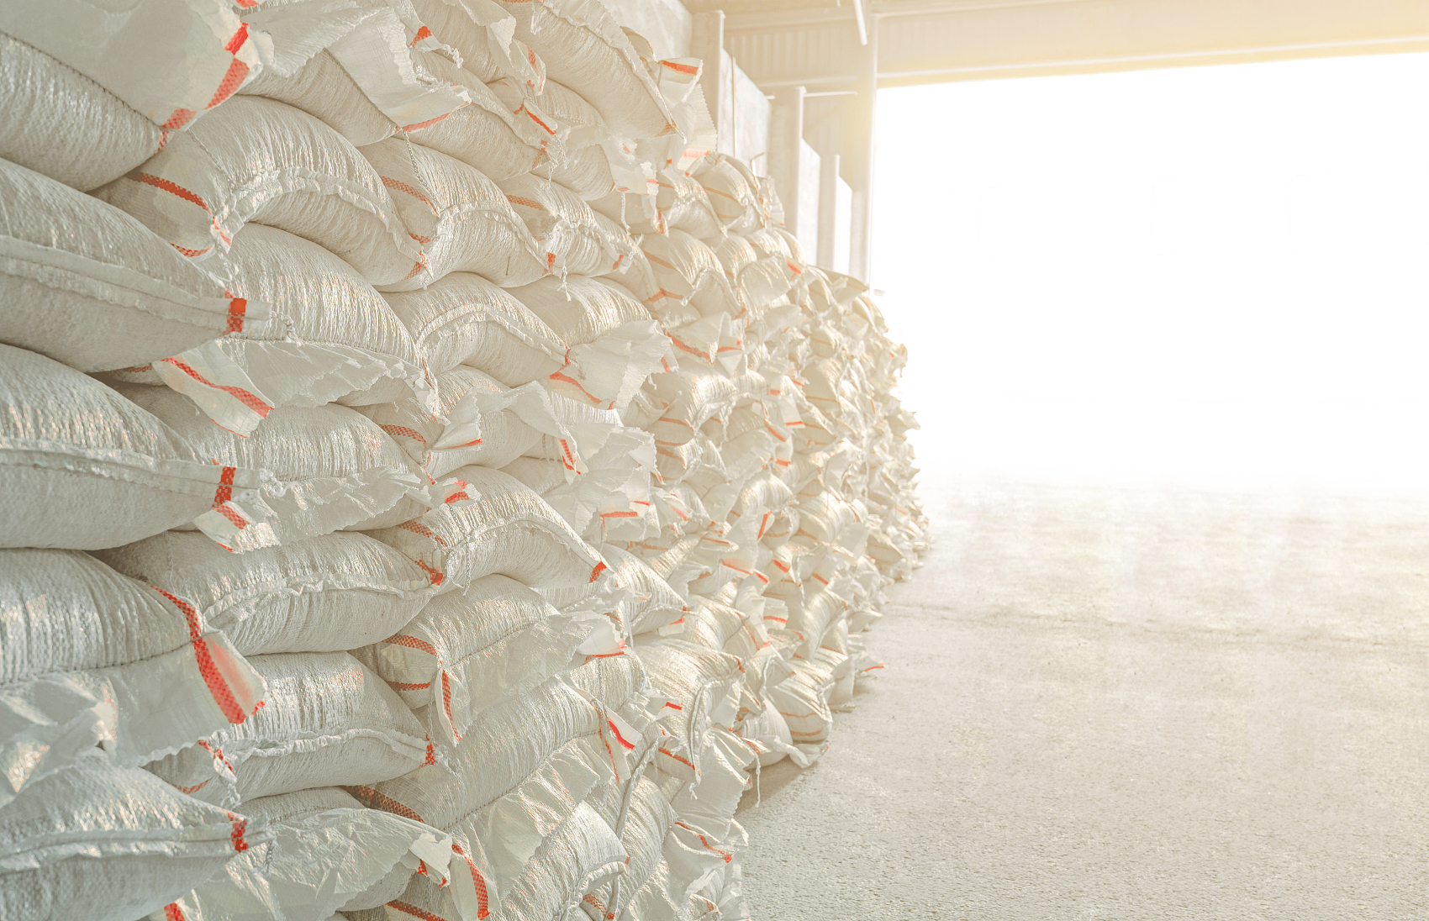

公司采购
——集体效应原则
比如采购大批量原材料，虽然单价低，但会增加仓储成本；采购小批量原材料，单价可能高，但仓储成本低。这时候就要计算总成本，找到最优平衡点。
某食品企业采购面粉，要是一次采购太多，需要租更大的仓库，还得承担面粉变质的风险；要是采购太少，频繁补货会增加运输成本，所以要根据生产需求和仓储能力确定采购量。
Notes:
{
"template_id": "T021",
"page_index": 1,
"layout_type": "title_with_text_image_grid",
"placeholders": [
{
"placeholder_id": "p1",
"type": "title",
"bbox": [0.1, 0.05, 0.8, 0.1],
"suggested_length": "5-10 chars",
"font_size": "40-52",
"note": "主标题（大纲中的二级标题），核心原则名称"
},
{
"placeholder_id": "p2",
"type": "body",
"bbox": [0.1, 0.18, 0.4, 0.35],
"suggested_length": "100-250 chars",
"font_size": "20-28",
"note": "左上长文本，用于解释原则含义或定义"
},
{
"placeholder_id": "p3",
"type": "image",
"bbox": [0.55, 0.18, 0.35, 0.35],
"note": "右上图片，用于展示与原则相关的示意图或图表"
},
{
"placeholder_id": "p4",
"type": "image",
"bbox": [0.1, 0.56, 0.35, 0.35],
"note": "左下图片，用于展示案例相关的图片或图示"
},
{
"placeholder_id": "p5",
"type": "body",
"bbox": [0.55, 0.56, 0.35, 0.35],
"suggested_length": "150-350 chars",
"font_size": "20-28",
"note": "右下长文本，用于展示具体案例或进一步说明"
}
],
"example_text": {
"title": "集体效应原则",
"body_left_top": "比如采购大批量原材料，虽然单价低，但会增加仓储成本；采购小批量原材料，单价可能高，但仓储成本低。这时候就要计算总成本，找到最优平衡点。",
"body_right_bottom": "某食品企业采购面粉，要是一次采购太多，需要租更大的仓库，还得承担面粉变质的风险；要是采购太少，频繁补货会增加运输成本，所以要根据生产需求和仓储能力确定采购量。"
},
"text_capacity_score": 0.6,
"visual_density": 0.5,
"recommended_usage": [
"原则解释与案例结合",
"图文交叉说明",
"成本平衡分析",
"采购策略展示"
],
"style_tags": ["网格布局", "图文结合", "案例驱动", "浅色背景"]
}

Slide 14

传统采购管理与现代采购管理的区别
——质量问题处理和信息沟通维度
如苹果公司会派驻工程师到核心芯片供应商工厂监督生产，从源头把控质量，到货后基本不重复检验；信息沟通通过网络实时进行，供应商能通过系统查看苹果生产计划提前备货，苹果也能实时查看供应商生产进度，有问题随时沟通。
Notes:
{
"template_id": "T012",
"page_index": 1,
"layout_type": "title_subtitle_image_text",
"placeholders": [
{
"placeholder_id": "p1",
"type": "title",
"bbox": [0.1, 0.08, 0.8, 0.12],
"suggested_length": "10-20 chars",
"font_size": "36-48",
"note": "主标题，核心主题或对比维度"
},
{
"placeholder_id": "p2",
"type": "subtitle",
"bbox": [0.1, 0.22, 0.8, 0.08],
"suggested_length": "10-30 chars",
"font_size": "28-36",
"note": "副标题，用于进一步说明对比的具体方面"
},
{
"placeholder_id": "p3",
"type": "image",
"bbox": [0.1, 0.35, 0.4, 0.5],
"note": "左侧矩形图片区域，用于放置对比示意图、流程图表或案例图片"
},
{
"placeholder_id": "p4",
"type": "body",
"bbox": [0.55, 0.35, 0.35, 0.5],
"suggested_length": "200-500 chars",
"font_size": "20-28",
"note": "右侧长文本区域，用于详细说明对比内容、案例分析或解释说明"
}
],
"example_text": {
"title": "传统采购管理与现代采购管理的区别",
"subtitle": "质量问题处理和信息沟通维度",
"body": "如苹果公司会派驻工程师到核心芯片供应商工厂监督生产，从源头把控质量，到货后基本不重复检验；信息沟通通过网络实时进行，供应商能通过系统查看苹果生产计划提前备货，苹果也能实时查看供应商生产进度，有问题随时沟通。"
},
"text_capacity_score": 0.6,
"visual_density": 0.5,
"recommended_usage": [
"维度对比分析",
"案例图文详解",
"区别说明",
"趋势对比展示"
],
"style_tags": ["图文对比", "左右分栏", "案例分析", "浅色背景"]
}

Slide 15

传统采购管理与现代采购管理的区别
——库存认知和供应商数量维度
华为采购5G芯片，主要和高通、联发科等少数几家合作，保证供应稳定和技术同步。
Notes:
{
"template_id": "T013",
"page_index": 1,
"layout_type": "title_subtitle_text_bottom_image",
"placeholders": [
{
"placeholder_id": "p1",
"type": "title",
"bbox": [0.1, 0.08, 0.8, 0.12],
"suggested_length": "10-20 chars",
"font_size": "36-48",
"note": "主标题，核心主题或对比维度"
},
{
"placeholder_id": "p2",
"type": "subtitle",
"bbox": [0.1, 0.22, 0.8, 0.08],
"suggested_length": "10-30 chars",
"font_size": "28-36",
"note": "副标题，用于进一步说明对比的具体方面"
},
{
"placeholder_id": "p3",
"type": "body",
"bbox": [0.1, 0.33, 0.8, 0.3],
"suggested_length": "100-300 chars",
"font_size": "20-28",
"note": "长文本区域，用于详细说明对比内容、案例分析或解释说明"
},
{
"placeholder_id": "p4",
"type": "image",
"bbox": [0.1, 0.66, 0.8, 0.25],
"note": "底部长方形图片区域，用于放置相关的主题图片、示意图或图标"
}
],
"example_text": {
"title": "传统采购管理与现代采购管理的区别",
"subtitle": "库存认知和供应商数量维度",
"body": "华为采购5G芯片，主要和高通、联发科等少数几家合作，保证供应稳定和技术同步。"
},
"text_capacity_score": 0.55,
"visual_density": 0.45,
"recommended_usage": [
"维度对比分析",
"案例图文详解",
"概念说明配图",
"趋势对比展示"
],
"style_tags": ["垂直布局", "图文结合", "案例分析", "浅色背景"]
}

Slide 16

采购管理的发展趋
——采购管理中心化
集团统一招标、统一谈判
既能降低成本，又能保证质量标准统一。
大型企业越来越倾向于把采购权集中到集团总部，比如中石化、中石油这样的央企
Notes:
{
"template_id": "T022",
"page_index": 1,
"layout_type": "title_subtitle_left_image_right_texts",
"placeholders": [
{
"placeholder_id": "p1",
"type": "title",
"bbox": [0.1, 0.08, 0.8, 0.12],
"suggested_length": "10-20 chars",
"font_size": "40-52",
"note": "主标题，发展趋势或主题"
},
{
"placeholder_id": "p2",
"type": "subtitle",
"bbox": [0.1, 0.22, 0.8, 0.08],
"suggested_length": "5-15 chars",
"font_size": "28-36",
"note": "副标题，具体发展方向"
},
{
"placeholder_id": "p3",
"type": "image",
"bbox": [0.1, 0.35, 0.4, 0.5],
"note": "左侧大图片，用于展示与内容相关的图表或示意图"
},
{
"placeholder_id": "p4",
"type": "body",
"bbox": [0.55, 0.35, 0.35, 0.12],
"suggested_length": "10-30 chars",
"font_size": "20-28",
"note": "右侧第一个文本，简要说明措施或做法"
},
{
"placeholder_id": "p5",
"type": "body",
"bbox": [0.55, 0.5, 0.35, 0.12],
"suggested_length": "10-30 chars",
"font_size": "20-28",
"note": "右侧第二个文本，说明优势或效果"
},
{
"placeholder_id": "p6",
"type": "body",
"bbox": [0.55, 0.65, 0.35, 0.2],
"suggested_length": "50-150 chars",
"font_size": "20-28",
"note": "右侧第三个文本，总结说明或案例"
}
],
"example_text": {
"title": "采购管理的发展趋势",
"subtitle": "采购管理中心化",
"body1": "集团统一招标、统一谈判",
"body2": "既能降低成本，又能保证质量标准统一。",
"body3": "大型企业越来越倾向于把采购权集中到集团总部，比如中石化、中石油这样的央企"
},
"text_capacity_score": 0.6,
"visual_density": 0.4,
"recommended_usage": [
"趋势介绍",
"中心化管理说明",
"图文结合展示",
"企业案例说明"
],
"style_tags": ["图文结合", "左侧图片右侧文字", "趋势展示", "浅色背景"]
}

Slide 17
采购管理的发展趋
——参与制造或外购决策
参与企业决策
提供数据支持
帮助企业做决策
Notes:
{
"template_id": "T031",
"page_index": 1,
"layout_type": "title_subtitle_three_short_texts",
"placeholders": [
{
"placeholder_id": "p1",
"type": "title",
"bbox": [0.1, 0.1, 0.8, 0.12],
"suggested_length": "10-20 chars",
"font_size": "40-52",
"note": "主标题，发展趋势或主题"
},
{
"placeholder_id": "p2",
"type": "subtitle",
"bbox": [0.1, 0.24, 0.8, 0.08],
"suggested_length": "10-20 chars",
"font_size": "28-36",
"note": "副标题，具体发展方向"
},
{
"placeholder_id": "p3",
"type": "body",
"bbox": [0.1, 0.35, 0.25, 0.15],
"suggested_length": "5-10 chars",
"font_size": "24-32",
"note": "第一个短文本，要点或关键词"
},
{
"placeholder_id": "p4",
"type": "body",
"bbox": [0.375, 0.35, 0.25, 0.15],
"suggested_length": "5-10 chars",
"font_size": "24-32",
"note": "第二个短文本，要点或关键词"
},
{
"placeholder_id": "p5",
"type": "body",
"bbox": [0.65, 0.35, 0.25, 0.15],
"suggested_length": "5-10 chars",
"font_size": "24-32",
"note": "第三个短文本，要点或关键词"
}
],
"example_text": {
"title": "采购管理的发展趋势",
"subtitle": "参与制造或外购决策",
"body1": "参与企业决策",
"body2": "提供数据支持",
"body3": "帮助企业做决策"
},
"text_capacity_score": 0.4,
"visual_density": 0.3,
"recommended_usage": [
"要点列举",
"趋势说明",
"简短列表展示",
"决策参与展示"
],
"style_tags": ["简洁", "文字主导", "分栏布局", "浅色背景"]
}

Slide 18

采购管理的发展趋
——网络采购
通过互联网平台实现招标、询价、签约等流程，比如阿里1688、京东企业购，都是常用的网络采购平台，能大幅提高采购效率。
Notes:
{
"template_id": "T011",
"page_index": 1,
"layout_type": "title_subtitle_text_large_image",
"placeholders": [
{
"placeholder_id": "p1",
"type": "title",
"bbox": [0.1, 0.1, 0.8, 0.12],
"suggested_length": "10-20 chars",
"font_size": "36-48",
"note": "主标题，整体主题或趋势名称"
},
{
"placeholder_id": "p2",
"type": "subtitle",
"bbox": [0.1, 0.24, 0.8, 0.08],
"suggested_length": "5-15 chars",
"font_size": "28-36",
"note": "副标题，用于说明具体的发展方向或细分主题"
},
{
"placeholder_id": "p3",
"type": "body",
"bbox": [0.1, 0.35, 0.8, 0.2],
"suggested_length": "100-250 chars",
"font_size": "20-28",
"note": "正文区域，用于详细解释概念、趋势或提供案例说明"
},
{
"placeholder_id": "p4",
"type": "image",
"bbox": [0.1, 0.58, 0.8, 0.35],
"note": "大型图片区域，用于展示相关的示意图、平台界面或流程图"
}
],
"example_text": {
"title": "采购管理的发展趋势",
"subtitle": "网络采购",
"body": "通过互联网平台实现招标、询价、签约等流程，比如阿里1688、京东企业购，都是常用的网络采购平台，能大幅提高采购效率。"
},
"text_capacity_score": 0.5,
"visual_density": 0.5,
"recommended_usage": [
"趋势介绍与图解",
"概念说明配图",
"技术或模式发展展示",
"平台或工具介绍"
],
"style_tags": ["图文结合", "垂直分层", "趋势展示", "浅色背景"]
}

Slide 19
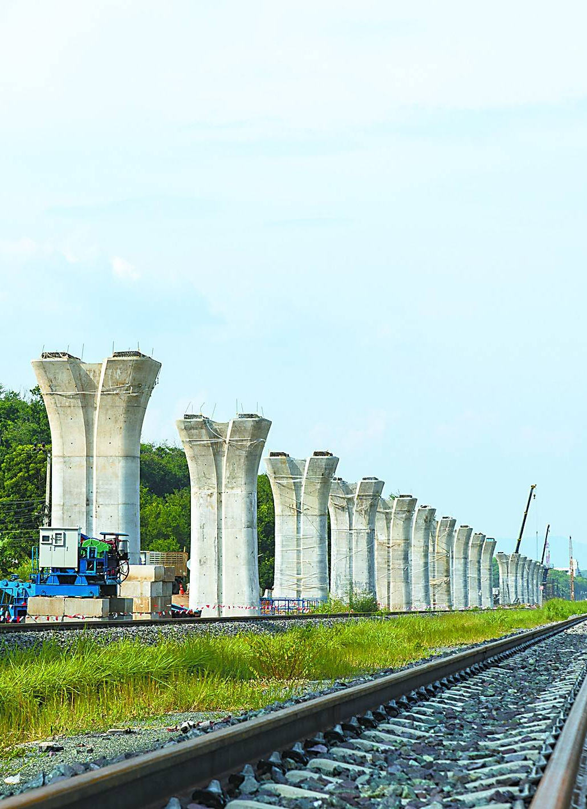
采购管理的发展趋
——绿色采购与可持续采购
中国企业在东南亚建设铁路时，采购当地的建材和服务，优先选择符合环保标准的供应商，同时为当地创造就业岗位；
在采购原材料时，严格遵守当地的劳动法规，杜绝使用童工、强制劳动等情况
这种采购模式不仅保证了项目的顺利推进，也向世界展示了中国企业的社会责任和大国担当，我们未来从业者也需要具备这样的全球视野。
Notes:
{
"template_id": "T030",
"page_index": 1,
"layout_type": "title_subtitle_three_long_bodies",
"placeholders": [
{
"placeholder_id": "p1",
"type": "title",
"bbox": [0.1, 0.08, 0.8, 0.12],
"suggested_length": "10-20 chars",
"font_size": "40-52",
"note": "主标题，发展趋势或主题"
},
{
"placeholder_id": "p2",
"type": "subtitle",
"bbox": [0.1, 0.22, 0.8, 0.08],
"suggested_length": "10-25 chars",
"font_size": "28-36",
"note": "副标题，具体发展方向或主题细化"
},
{
"placeholder_id": "p3",
"type": "body",
"bbox": [0.1, 0.32, 0.8, 0.2],
"suggested_length": "100-250 chars",
"font_size": "20-28",
"note": "第一个长文本，用于描述案例或实践的第一部分"
},
{
"placeholder_id": "p4",
"type": "body",
"bbox": [0.1, 0.54, 0.8, 0.2],
"suggested_length": "100-250 chars",
"font_size": "20-28",
"note": "第二个长文本，用于描述案例或实践的第二部分"
},
{
"placeholder_id": "p5",
"type": "body",
"bbox": [0.1, 0.76, 0.8, 0.2],
"suggested_length": "100-250 chars",
"font_size": "20-28",
"note": "第三个长文本，用于总结或展望"
}
],
"example_text": {
"title": "采购管理的发展趋势",
"subtitle": "绿色采购与可持续采购",
"body1": "中国企业在东南亚建设铁路时，采购当地的建材和服务，优先选择符合环保标准的供应商，同时为当地创造就业岗位；",
"body2": "在采购原材料时，严格遵守当地的劳动法规，杜绝使用童工、强制劳动等情况。",
"body3": "这种采购模式不仅保证了项目的顺利推进，也向世界展示了中国企业的社会责任和大国担当，我们未来从业者也需要具备这样的全球视野。"
},
"text_capacity_score": 0.75,
"visual_density": 0.25,
"recommended_usage": [
"案例详细分析",
"可持续发展实践展示",
"企业社会责任说明",
"多段落叙述性内容"
],
"style_tags": ["文字主导", "垂直排列", "案例叙述", "浅色背景"]
}

Slide 20



采购管理的发展趋
——智能化采购
用大数据分析市场价格趋势，预测原材料价格上涨，提前锁定采购成本；
用物联网实时跟踪货物运输情况。
用人工智能自动筛选供应商，根据供应商的历史供货数据、质量评分，自动推荐最优供应商；
Notes:
{
"template_id": "T029",
"page_index": 1,
"layout_type": "title_subtitle_three_icon_texts",
"placeholders": [
{
"placeholder_id": "p1",
"type": "title",
"bbox": [
0.1,
0.08,
0.8,
0.12
],
"suggested_length": "10-20 chars",
"font_size": "40-52",
"note": "主标题，发展趋势或主题"
},
{
"placeholder_id": "p2",
"type": "subtitle",
"bbox": [
0.1,
0.22,
0.8,
0.08
],
"suggested_length": "5-15 chars",
"font_size": "28-36",
"note": "副标题，具体发展方向"
},
{
"placeholder_id": "p3",
"type": "image",
"bbox": [
0.1,
0.35,
0.2,
0.2
],
"note": "第一个圆形图标，代表大数据分析"
},
{
"placeholder_id": "p4",
"type": "body",
"bbox": [
0.1,
0.57,
0.2,
0.35
],
"suggested_length": "50-150 chars",
"font_size": "18-26",
"note": "第一个长文本，描述大数据应用"
},
{
"placeholder_id": "p5",
"type": "image",
"bbox": [
0.4,
0.35,
0.2,
0.2
],
"note": "第二个圆形图标，代表物联网"
},
{
"placeholder_id": "p6",
"type": "body",
"bbox": [
0.4,
0.57,
0.2,
0.35
],
"suggested_length": "50-150 chars",
"font_size": "18-26",
"note": "第二个长文本，描述物联网应用"
},
{
"placeholder_id": "p7",
"type": "image",
"bbox": [
0.7,
0.35,
0.2,
0.2
],
"note": "第三个圆形图标，代表人工智能"
},
{
"placeholder_id": "p8",
"type": "body",
"bbox": [
0.7,
0.57,
0.2,
0.35
],
"suggested_length": "50-200 chars",
"font_size": "18-26",
"note": "第三个长文本，描述人工智能应用"
}
],
"example_text": {
"title": "采购管理的发展趋势",
"subtitle": "智能化采购",
"body1": "用大数据分析市场价格趋势，预测原材料价格上涨，提前锁定采购成本；",
"body2": "用物联网实时跟踪货物运输情况。",
"body3": "用人工智能自动筛选供应商，根据供应商的历史供货数据、质量评分，自动推荐最优供应商；"
},
"text_capacity_score": 0.6,
"visual_density": 0.5,
"recommended_usage": [
"技术应用介绍",
"智能化趋势展示",
"多技术点并列说明",
"图文结合展示"
],
"style_tags": [
"图文结合",
"三栏布局",
"圆形图标",
"浅色背景"
]
}

Slide 21
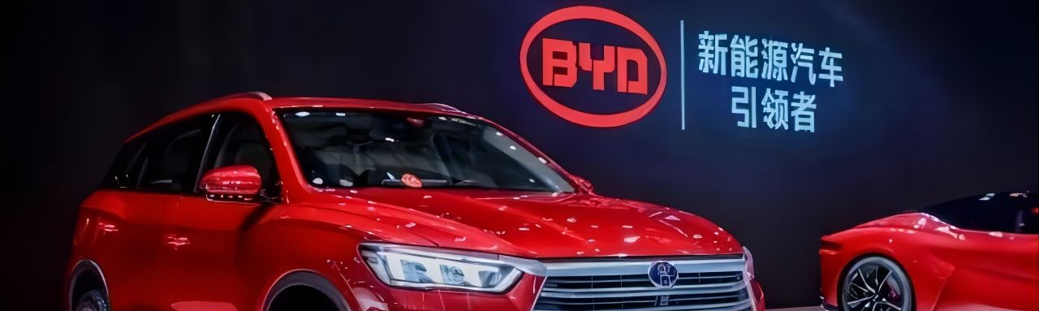
公司采购
——采购原则
他们不仅考察供应商的价格和质量，还会严格审核供应商的环保资质，要求供应商必须符合国家环保标准，减少碳排放。
比亚迪会和供应商协同优化运输方案，采用铁路运输、集中配送等方式，降低物流成本和环境影响。
咱们国家的新能源汽车企业比亚迪，在采购电池原材料时，始终坚持集体效应和可持续发展原则。
这种采购不仅满足了企业生产需求，还承担了社会责任，推动了整个供应链的绿色发展，这就是采购原则和社会责任的完美结合。
Notes:
{
"template_id": "T036",
"page_index": 1,
"layout_type": "title_four_bodies",
"placeholders": [
{
"placeholder_id": "p1",
"type": "title",
"bbox": [0.1, 0.05, 0.8, 0.1],
"suggested_length": "5-10 chars",
"font_size": "40-52",
"note": "主标题，页面主题"
},
{
"placeholder_id": "p2",
"type": "body",
"bbox": [0.1, 0.18, 0.8, 0.17],
"suggested_length": "100-250 chars",
"font_size": "20-28",
"note": "第一个长文本，阐述原则或案例"
},
{
"placeholder_id": "p3",
"type": "body",
"bbox": [0.1, 0.37, 0.8, 0.17],
"suggested_length": "100-250 chars",
"font_size": "20-28",
"note": "第二个长文本，阐述原则或案例"
},
{
"placeholder_id": "p4",
"type": "body",
"bbox": [0.1, 0.56, 0.8, 0.17],
"suggested_length": "100-250 chars",
"font_size": "20-28",
"note": "第三个长文本，阐述原则或案例"
},
{
"placeholder_id": "p5",
"type": "body",
"bbox": [0.1, 0.75, 0.8, 0.17],
"suggested_length": "100-250 chars",
"font_size": "20-28",
"note": "第四个长文本，总结或结合社会责任"
}
],
"example_text": {
"title": "采购原则",
"body1": "他们不仅考察供应商的价格和质量，还会严格审核供应商的不保资质，要求供应商必须符合国家环保标准，减少碳排放。",
"body2": "比亚迪会和供应商协同优化运输方案，采用铁路运输、集中配送等方式，降低物流成本和环境影响。",
"body3": "咱们国家的新能源汽车企业比亚迪，在采购电池原材料时，始终坚持集体效应和可持续发展原则。",
"body4": "这种采购不仅满足了企业生产需求，还承担了社会责任，推动了整个供应链的绿色发展，这就是采购原则和社会责任的完美结合。"
},
"text_capacity_score": 0.8,
"visual_density": 0.25,
"recommended_usage": [
"原则阐述",
"案例说明",
"多段落展示",
"社会责任展示"
],
"style_tags": ["简洁", "文字主导", "垂直排列", "浅色背景"]
}

Slide 22


公司采购
——采购管理的作用
企业采购不仅要追求经济效益，还需承担社会责任，如优先采购环保材料、支持中小企业、杜绝采购腐败。
采购人员作为执行者，要坚守诚信合规底线，不接受回扣、不为私利选不合格供应商，这既是职业操守，也是法律要求。
Notes:
{
"template_id": "T037",
"page_index": 1,
"layout_type": "title_two_bodies",
"placeholders": [
{
"placeholder_id": "p1",
"type": "title",
"bbox": [0.1, 0.1, 0.8, 0.15],
"suggested_length": "5-15 chars",
"font_size": "40-52",
"note": "主标题，主题名称"
},
{
"placeholder_id": "p2",
"type": "body",
"bbox": [0.1, 0.3, 0.8, 0.3],
"suggested_length": "100-250 chars",
"font_size": "20-28",
"note": "第一个长文本，用于详细说明第一个要点"
},
{
"placeholder_id": "p3",
"type": "body",
"bbox": [0.1, 0.63, 0.8, 0.3],
"suggested_length": "100-250 chars",
"font_size": "20-28",
"note": "第二个长文本，用于详细说明第二个要点"
}
],
"example_text": {
"title": "采购管理的作用",
"body1": "企业采购不仅要追求经济效益，还需承担社会责任，如优先采购环保材料、支持中小企业、杜绝采购腐败。",
"body2": "采购人员作为执行者，要坚守诚信合规底线，不接受回扣、不为私利选不合格供应商，这既是职业操守，也是法律要求。"
},
"text_capacity_score": 0.7,
"visual_density": 0.3,
"recommended_usage": [
"作用阐述",
"要点说明",
"多段落展示",
"社会责任与职业操守"
],
"style_tags": ["简洁", "文字主导", "垂直排列", "浅色背景"]
}

Slide 23
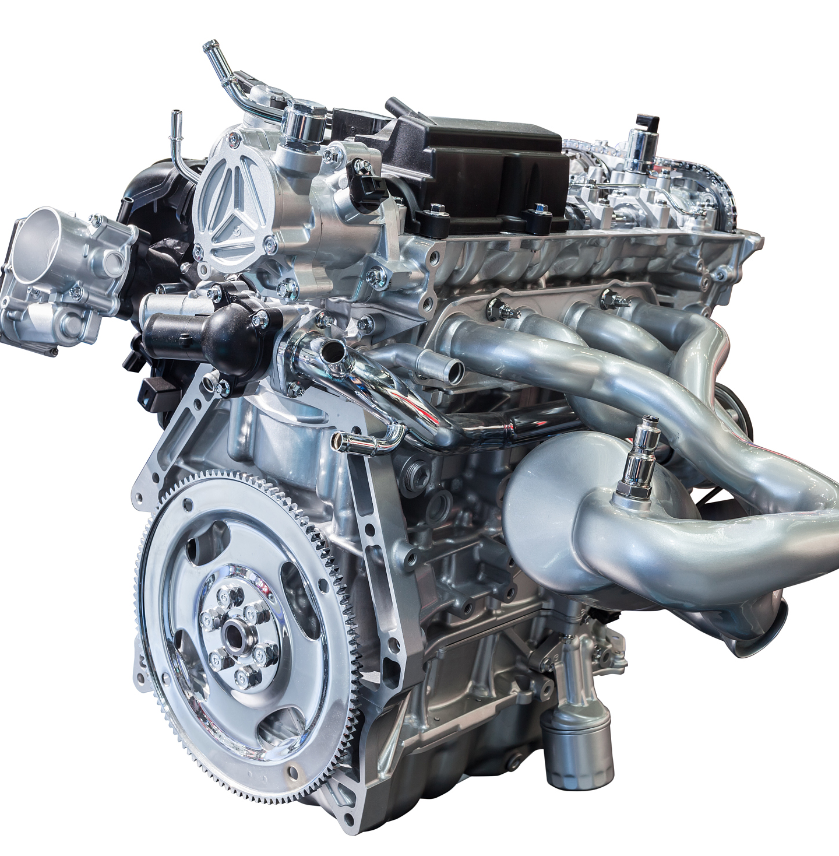


公司采购
——采购的主体和客体
有形商品采购
无形服务采购
项目采购
Notes:
{
"template_id": "T025",
"page_index": 1,
"layout_type": "title_with_three_image_caption_cards",
"placeholders": [
{
"placeholder_id": "p1",
"type": "title",
"bbox": [0.1, 0.08, 0.8, 0.15],
"suggested_length": "5-12 chars",
"font_size": "40-52",
"note": "主标题，核心主题"
},
{
"placeholder_id": "p2",
"type": "image",
"bbox": [0.06, 0.28, 0.25, 0.26],
"note": "左侧图片，代表第一种采购类型"
},
{
"placeholder_id": "p3",
"type": "caption",
"bbox": [0.06, 0.56, 0.25, 0.08],
"suggested_length": "2-8 chars",
"font_size": "20-28",
"note": "左侧图片下方的文本描述"
},
{
"placeholder_id": "p4",
"type": "image",
"bbox": [0.37, 0.28, 0.25, 0.26],
"note": "中间图片，代表第二种采购类型"
},
{
"placeholder_id": "p5",
"type": "caption",
"bbox": [0.37, 0.56, 0.25, 0.08],
"suggested_length": "2-8 chars",
"font_size": "20-28",
"note": "中间图片下方的文本描述"
},
{
"placeholder_id": "p6",
"type": "image",
"bbox": [0.68, 0.28, 0.25, 0.26],
"note": "右侧图片，代表第三种采购类型"
},
{
"placeholder_id": "p7",
"type": "caption",
"bbox": [0.68, 0.56, 0.25, 0.08],
"suggested_length": "2-8 chars",
"font_size": "20-28",
"note": "右侧图片下方的文本描述"
}
],
"example_text": {
"title": "采购的主体和客体",
"captions": ["有形商品采购", "无形服务采购", "项目采购"]
},
"text_capacity_score": 0.4,
"visual_density": 0.5,
"recommended_usage": [
"分类展示",
"要点列举",
"概念介绍",
"三类内容展示"
],
"style_tags": ["图文结合", "分栏布局", "分类展示", "浅色背景"]
}

